Slide 1

The Budget Issues Committee Presents: Position Count and FTE Definition and Calculation

Slide 2
Position Count & FTE Definition
Initiative of Budget Issues Committee to standardize and ensure accuracy across USG
Reported on 3 different submissions:
  Online Budget System – Original Budget + Amendments
  Original Budget Questionnaire
  Annual Expenditure Report (AER)

Slide 3
Position Count & FTE Definition
The Budget Issues Committee has determined that Full Time Equivalent (FTE) calculations will utilize the Pers_Serv_BOR table in PeopleSoft Financials.
To ensure the FTE calculation is accurate, institutions will need to properly maintain the table by entering all adjustments and corrections through ADP

Slide 4
Online Budget System
Definition: The Position Counts submitted in the Online Budget System are given to the Office of Planning and Budget (OPB) and those counts are included in state-wide reports.
  Original Budget
  Quarterly Amendments

Slide 5
Online Budget System
Include:
  Full Time filled and budgeted vacant positions
  Employees working 30 hours per week or more & receiving full benefits
  Full Time faculty reported as 1 – not .75
  Split funded positions must equal 1 in the final count

Slide 6
Online Budget System
Additional Notes:
  Auxiliary Services and Student Activities position counts are reported separately in the Supplementary Information section
  Do not include full time equivalents for part time positions
  Do not include positions that no longer have a budget
  Do not include partially benefited positions

Slide 7
Online Budget System
Original Budget Submission Calculation:
  Run the BOR_BP_BUDAGG query
  Create a pivot table to count positions by fund and pay group
  Identify split funded positions and count the value of the position by fund
  Do not double count backfill positions

Slide 8
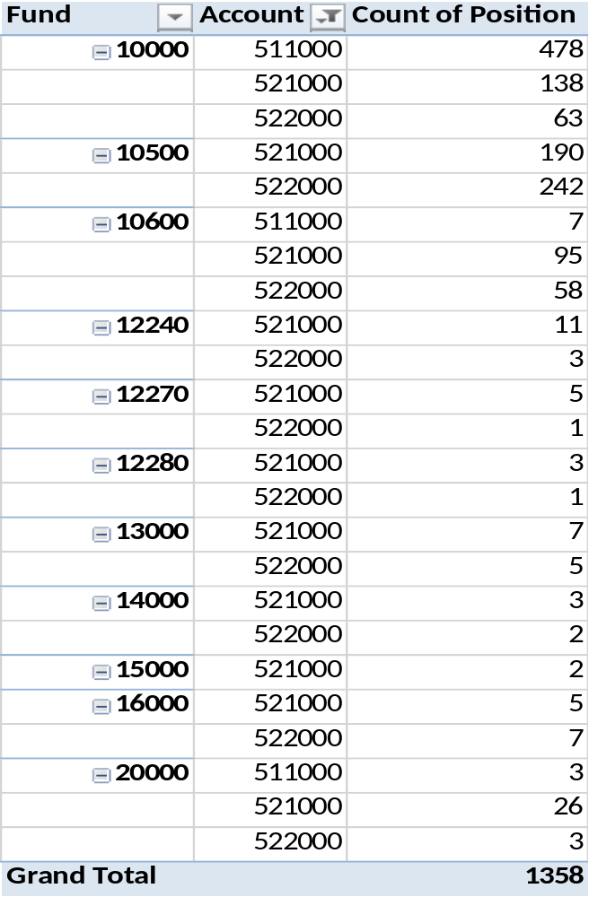
Online Budget System

Slide 9
Online Budget System
Quarterly Amendment Example:
  Run the ADP Budget Extract file
  Create a pivot table to count positions by fund and pay group
  Identify split funded positions and count the value of the position by fund
  Do not double count backfill positions

Slide 10
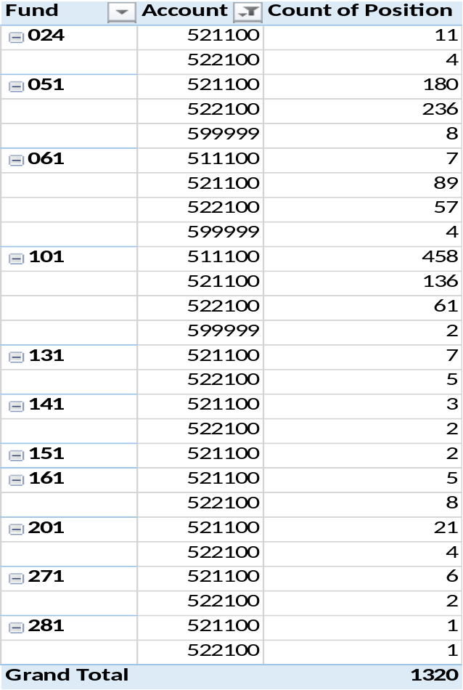
Online Budget System

Slide 11
Original Budget Questionnaire
Definition: The System Office uses this count to determine the reliance on part time versus full time faculty and to respond to any inquiries from State government or media outlets regarding the number of positions funded by the University System.

Slide 12
Original Budget Questionnaire
Report the full time filled and full time budgeted vacant positons that the institution intends to fill
Include positions from all funds
Full time faculty reported as 1 not .75
Full Time position count should match the position count entered in the Online Budget System

Slide 13
Original Budget Questionnaire
Include the full time equivalent of part time faculty
Do not include Student Assistants, Graduate Assistants, or any other non-benefited employee other than part time faculty
Do not include employees who are partially benefited

Slide 14
Original Budget Questionnaire
Part Time Faculty FTE Calculation:
  Use a query from the Pers_Serv_BOR table
    BOR_ADP_PERSSERV_DTL
    Institutional Query
  Run query for October in the prior fiscal year
  Use part time faculty pay group/account code to determine the amount paid to part time faculty for the month of October

Slide 15
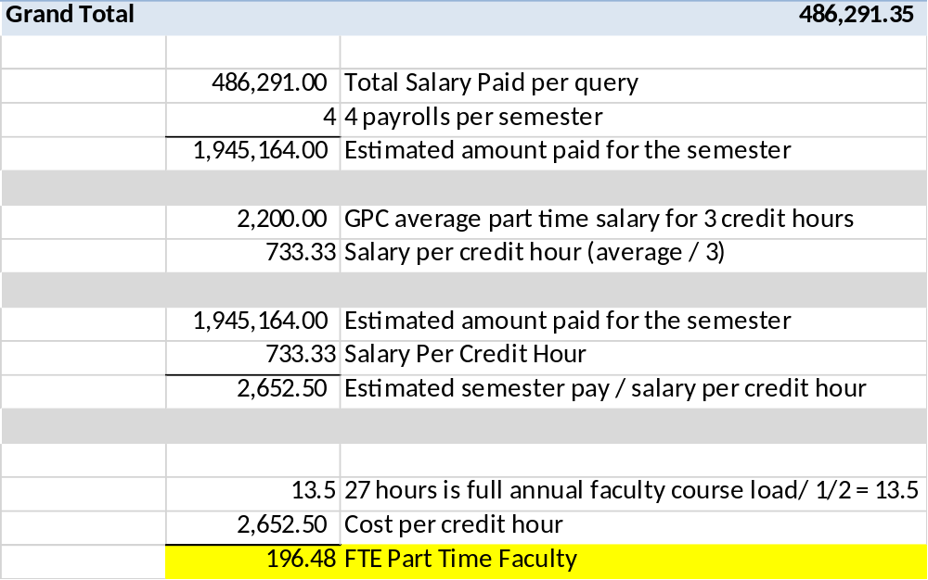
Original Budget Questionnaire
Part Time Faculty FTE Calculation:

Slide 16
Annual Expenditure Report
Definition: The System Office uses this count to report the impact of the University System on the Georgia economy. This data needs to be consistent and reliable.

Slide 17
Annual Expenditure Report (AER)
Include all filled full time and part time FTE (full time equivalent)
Include funds reported on the AER
Full Time faculty reported as 1 not .75
Split funded positions should count as 1 in the overall total
Do not include budgeted vacant positions

Slide 18
Annual Expenditure Report (AER)
Full Time filled position count is calculated using a query on the Pers_Serv_Bor table for the month of October in the fiscal year being reported
    BOR_ADP_PERSSERV_DTL
    Institutional Query
Ensure that staff paid bi-weekly are only counted once

Slide 19
Annual Expenditure Report (AER)
Part Time Faculty FTE count is calculated using a query on the Pers_Serv_Bor table for the month of October in the fiscal year being reported
Use the same calculation process as the Original Budget Questionnaire

Slide 20
Annual Expenditure Report (AER)
Part Time Staff count is calculated using a query on the Pers_Serv_Bor table for the month of October in the fiscal year being reported
  Use ADP Reporter to obtain hourly pay by employee
  Use Vlookup to add the hourly pay to the Pers_Serv_BOR query data

Slide 21
Annual Expenditure Report (AER)
Calculate the number of hours worked by dividing the amount expended by the hourly rate
Use a pivot table to filter pay groups C and T and the appropriate pay runs
Sum the total hours worked by employee

Slide 22
Annual Expenditure Report (AER)
October 2015 had 3 bi-weekly payrolls
  GPC used the 2nd and 3rd bi-weekly pay to determine the FTE as it was more representative of the month of October
  2 bi-weekly payrolls represent 20 working days
  Full Time Equivalent is 20 x 8 or 160 hours
  Divide the total hours worked by 160 to determine FTE

Slide 23
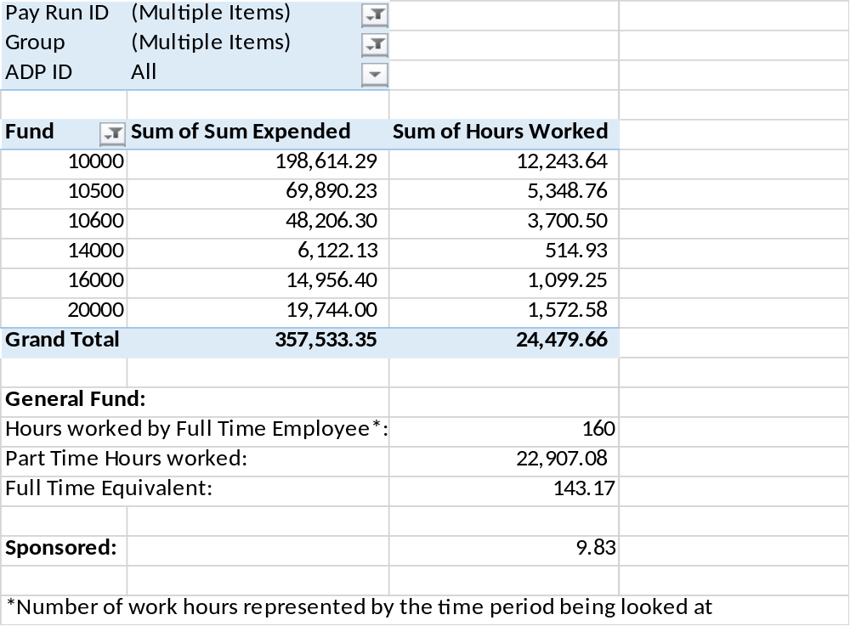
Annual Expenditure Report (AER)

Slide 24
Discussion Items
How to identify split funded positions?
Do you include College Work Study in sponsored amounts on the AER?
Do you include Summer Faculty in the FTE?
Do you only include REG earnings or should Overtime, Additional Straight Time, or Extra Pay be included?
Other issues?

Slide 25
Questions?
Contact your sector representative on the Budget Issues Committee
  http://www.usg.edu/gafirst-fin/budget_issues_committee/
  Budget Issues Committee Meeting 4:20 pm today!

